Slide 1

Python in data science

Slide 2
Introduction
Project title:- movie recommendation
Name:- Ayush c. Panchal
Enrolment no:- 21005031540

Slide 3
Brief of project
Data Analysis with the movie name and datasets of movies till 2002
It recommend us that which movie we should watch next. Dataset has been downloaded from Github. The data set contain Two files : movie title.csv and udata.csv.

Slide 4
About dataset used in project
User_ id
Movie title
Rating
Year
User data

Slide 5
What we have analyzed …!
We can recommend particular person for which movie he /she
Can watch after completion of one.
It also recommend the similar movies.
We can also check the ratings of the movies.

Slide 6
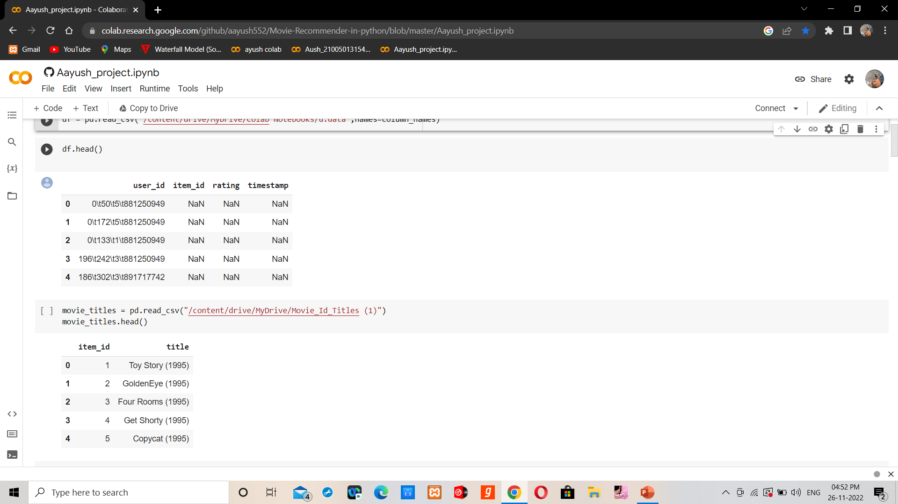
Some results..

Slide 7
conclusion
The movie data analysis used to understand data. We the help of data analysis we can find pros and cons of the movie and the rating of the particular movie.
A person can also add the ratings.
Its help the viewer for which movie he /she can watch .

Slide 8
Useful links
https://colab.research.google.com/github/aayush552/Movie-Recommender-in-python/blob/master/Aayush_project.ipynb
https://github.com/aayush552/Movie-Recommender-in-python

Slide 9
Thank you..

